Slide 1

jQuery: JavaScript, Made Easy
By:- Prof. Jignasha Rajput
Notes:
I will assume that everyone has at least a loose understanding of Javascript and HTML already.

Slide 2
What is jQuery?
jQuery is JavaScript.
jQuery is a Framework, a collection of “shortcuts”
jQuery is a platform for modernization.
jQuery is open-source.

Slide 3
jQuery is…
Everything that is done in jQuery can be done in JavaScript. Everything that is done in jQuery IS being done in JavaScript.
Everything in jQuery is designed to make your JavaScript simpler and cut down on development time.
One of the major advantages to jQuery is it’s ability to implement open-source plugins from a vast online library that can add functionality to a web site with a very small time investment required.
document.getElementById("id") = $("#id")

Slide 4
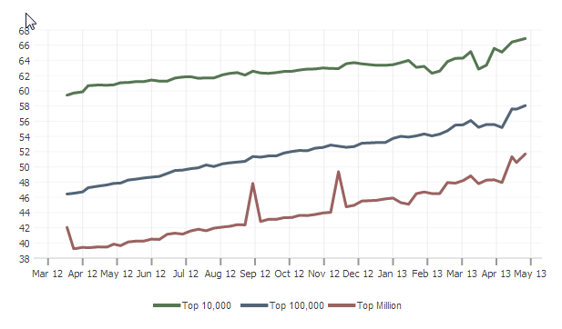
Where is jQuery used?
jQuery is leveraged in the majority of the top 10,000 and 100,000 web sites on the internet today.
Source: http://trends.builtwith.com/javascript/jQuery
Notes:
I’m not big on internet stats normally, but this statistic is inline with most numbers I have seen. Also, in case you were wondering, it’s built with jQuery.

Slide 5
What can jQuery do for me?
Besides just making my javascript easier…
Notes:
Maybe the most important question you can ask.

Slide 6
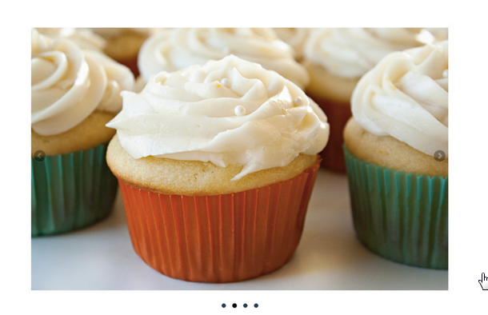
Sliders
https://artsandlectures.sa.ucsb.edu/

Slide 7
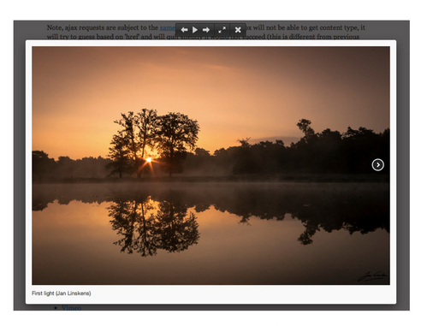
Galleries
http://wellness.sa.ucsb.edu/Labyrinth.aspx

Slide 8
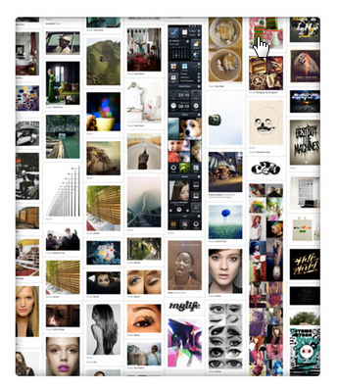
Layouts
http://pinterest.com/
Notes:
Pinterest?

Slide 9
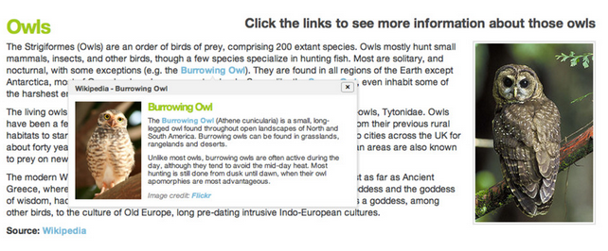
Tooltips

Slide 10
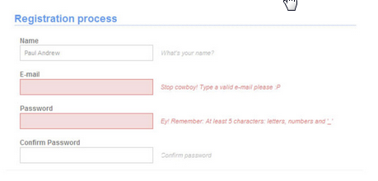
Validation
http://bit.ly/14DLGil
Notes:
OSL’s OrgSync – not positive this is jQuery – appears to be using JSON via jQuery

Slide 11
How do I use jQuery?
<!-- jQuery.com CDN -->
<script src="http://code.jquery.com/jquery-1.9.1.min.js"></script>
<!-- Google hosted CDN -->
<script src="http://ajax.googleapis.com/ajax/libs/jquery/1.9.1/jquery.min.js"></script> <!-- Microsoft hosted CDN -->
<script src="http://ajax.aspnetcdn.com/ajax/jquery/jquery-1.9.1.min.js"></script>
<!-- Self-hosted -->
<script src="scripts/jquery.min.js"></script>
Notes:
Lines 8-11
Go to jquery.com
Download jquery 1.9.1
Explain compressed vs. uncompressed (production/development)
Save to scripts folder

Slide 12
How do I know if it’s working?
Here is a simple bit a code that you can run to confirm that jQuery is running on your page.
<script type="text/javascript">
if (jQuery) {
alert("jQuery is loaded");
}
</script>
<script type="text/javascript">
if ($) {
alert("jQuery is loaded");
}
</script>
Notes:
Lines 15-18
Write this in the <head> AFTER the jquery reference
Type=“text/javascript” information:
For HTML 4.X, the type attribute is required. In HTML 5, it is optional. If it is not specified, it defaults to text/javascript. So, from here on out I’ll exclude it from my examples.
http://www.w3.org/TR/REC-html40/interact/scripts.html
http://dev.w3.org/html5/spec/Overview.html#script
The “$” is an alias for jQuery.

Slide 13
It works! What now?
Let’s take a look at the three ways in jQuery to launch a script when a page loads.

Slide 14
1.
<script>
$(document).ready(function () {
// Your code goes here
});
</script>
Document.ready
Notes:
Lines 23-27

Slide 15
2.
<script>
window.onload = function() {
// Your code goes here
});
</script>
Window.Onload
Notes:
Lines 28-32

Slide 16
3.
<script>
$(function(){
// Your code goes here
});
</script>
Anonymous function()
Preferred method.
Notes:
Lines 33-37
Similar to the window.load() script.

Slide 17
Let’s try our first script…
Hello World:
<script>
$(function () {
alert("Hello World");
});
</script>
Now let’s refine our script…
Notes:
Uncomment all of 42-69
Line 46
This simple function should pop an alert window after page load.

Slide 18
Selectors
Selectors are what make jQuery so clean and efficient.
Selectors are what makes jQuery EASY!
<button>Sample</button>
<script>
$(function () {
$("button").click(function () {
alert("Hello World");
});
});
</script>
Notes:
button is the selector for a <button> tag.
A for anchor tags
Span for <span>’s
Div for <div>’s
There are ID specific selectors and CLASS specific selectors also – you might recognize them as CSS selectors! These are really the power of jQuery and we will look into them in the next few slides.
And so on!

Slide 19
Objects and DOM elements
In the following slides we will compare code samples written in pure JavaScript versus their equivalent code in jQuery…
Notes:
Now that we have used a DOM element in a script, let’s talk efficiency in development and readability when it comes to objects and DOM elements…
In the next couple of slides, try not to worry to much about what the code is doing and let’s just look at the code for it’s usability. We’ll dig into what’s actually happening with the code a little later on.
The Document Object Model (DOM for short) is a representation of an HTML document.

Slide 20
Objects and DOM elements
Javascript
Jquery
document.getElementById("targetId");
document.getElementsByClassName("targetClass");
document.getElementsByName("targetName");
document.getElementsByTagName("targetTag");
$("#targetId");
$(".targetClass");
$('[name="targetName"]');
$("targetTag");
Notes:
The pound sign is to represent tags by Id.
The period is to represent tags by class.
Pseudo classes (attributes) can be called with brackets and the value of the attribute.
To get all tags of a certain type just write the tag name.

Slide 21
Objects and DOM elements - Semantics
Javascript
jquery
<a onclick="doSomething()" href="#">Click!</a>
$('a.doSomething').click(function () { alert(‘Do Something'); });
var a = document.createElement('a'); a.href = 'http://www.ucsb.ed'; a.title = 'UCSB'; a.innerHTML = 'UCSB Homepage'; a.target = '_blank'; document.getElementById('body').appendChild(a);
$('<a/>', { href: 'http://www.ucsb.edu', title: 'UCSB', html: 'UCSB Homepage', target: '_blank' }).appendTo('body');

Slide 22
One last comparison...
JAvascript
jquery
var xhr; try { xhr = new XMLHttpRequest(); } catch (e) { try { xhr = new ActiveXObject("Msxml2.XMLHTTP"); } catch (e) { xhr = new ActiveXObject("Microsoft.XMLHTTP"); } } xhr.open("GET", "test.txt", true); xhr.onreadystatechange = function () { if (xhr.readyState == 4) { alert(xhr.responseText) } } xhr.send(null)
$.get('test.txt', function (xhr) { alert(xhr); });
Notes:
I went out and found this sample online just to give you an idea of the power of jQuery.
I’ll try not to get into the detail of what this does, but just show the elegancy of the code.
Sends a request to retrieve the contents of a text file and displays an alert of the contents.
What took plain JavaScript 19 lines to do, jQuery accomplished in 3 lines of code. Granted most AJAX calls made today are through some sort of library as to greatly reduce the amount of code and the headaches of initializing the XmlHttpRequest object.

Slide 23
Events
The .click() function we just created is called an event. There are many events in jQuery that you can use to turn ordinary DOM elements into functional tools in your web site.
<button>Sample</button>
<input type="text" value="Sample" />
<script>
$(function () {
$("button").click(function () {
$("input").val("Changed");
$("input").change();
});
$("input").change(function () {
alert("Handler for .change() called.");
});
});
</script>
<script>
$(function () {
$("button").click(function () {
$("input").val("Changed");
//$("input").change();
});
$("input").change(function () {
alert("Handler for .change() called.");
});
});
</script>
Notes:
[C]
Events are what make DOM elements do anything. Let’s expand our example again.
(Document Object Model)
[C]
This is an interesting example of jQuery events being used in combination. With the change event call commented out the button click doesn’t fire the change event. The change event is only fired with editing the textbox.
[C]
When we uncomment the change event call it fires on the button click.
In this example we use our event to introduce another facet of jQuery – Attributes (val())

Slide 24
Attributes
jQuery has several attributes that you can leverage to modify DOM elements. The most basic is .attr(). This attribute allows you to modify any key/value pair associated with an element.
<div id="coloredDiv"></div>
<script>
$(function () {
$("button").click(function () {
$("input").val("Changed");
$("#coloredDiv").attr("style", "background-color:red;height:100px; width:100px;");
//$("input").change(); });
$("input").change(function () {
alert($("#coloredDiv").attr("style"));
});
});
</script>
In our example "style", "background-color:red;height:100px; width:100px;“ is our key/value pair.
Notes:
[C]
Let’s add another DOM element. A div this time…
[C]
Let’s comment out the .change() event call. In hopes to conserve space I’ll remove the .change event handler – you don’t need to remove it. This script leverages a very powerful attribute - .attr() This is the most basic of jQuery attributes. It acts as a getter and a setter. In our example script we use it as both. The setter happens first during the button click. Then we use it as a getter in the change() event handler.

Slide 25
Attributes
The .attr() method can also accept an object of multiple key/value pairs. In the following example we will set the href value using jQuery:
<a href="#" class="siteLink">Sample</a>
$(".siteLink").attr("href", "allMyHrefsAreTheSameNow.html");
In this example we will set both the HREF value and the Title attribute simultaneously:
$(".siteLink").attr({ title: "all titles are the same too!", href: "somethingNew.html" });
This sort of script could be handy in many situations when modernizing a site. For instance, updating all images to have alt tags on a give page.

Slide 26
CSS Attributes
That .attr() tag was a little ugly, not semantic and really not a great way to control CSS. Let’s look at other ways to control CSS of DOM elements.
$("#coloredDiv").css({ backgroundColor : "red", // or "background-color" : "red" height : "100px", width : "100px“ });
$("#coloredDiv").addClass("redBox"); $("#coloredDiv").removeClass("blueBox"); $("#coloredDiv").toggleClass("coloredBox");
Notes:
We like the attr() tag. It’s very handy and a nice catch all. But not semantic and sort of awkward especially with CSS. Let’s look at better ways to control CSS using jQuery.
[C]
Much cleaner. Much easier to read. Much easier to modify down the road. But still clunky and still you have CSS that is handled manually.
[C]
CSS managed correctly! Add a CSS class. Remove a CSS class. Toggle a CSS class on/off with an event – a button click for example.

Slide 27
Advanced Selectors
Want to find Advanced Selectors?

